Slide 1
Software Architectures
Lecture 10: Cloud Computing
Professor
Yushan (Michael) Sun
Fall 2020

Slide 2
Content：
云计算引言
云计算的概念
云服务交付模型
SaaS的多租户架构
云计算的NIST架构
网格计算与云计算的比较
云计算关键技术*

Slide 3
Introduction to Cloud Computing
云计算引言

Slide 4
1. Introduction to Cloud Computing
大型互联网企业出租冗余的资源与服务；因此，要出租资源与服务
Amazon：
Amazon wanted to provide cloud computing to external customers, and
launched Amazon Web Services (AWS) on a utility computing basis in 2006.
IBM：
IBM announced the IBM SmartCloud framework to support Smarter Planet in 2001.
Cloud computing is a critical component of the Smarter Computing foundation.

Slide 5
1. Introduction to Cloud Computing
企业改变了经营方式，租用设备：
The term "moving to cloud" also refers to an organization moving away from a
  traditional CAPEX model (buy the dedicated hardware and depreciate it over a period of time) 资本支出模式(购买专门的硬件设备，而很快就贬值了) to
  the OPEX model (use a shared cloud infrastructure and pay as you use it). 运营支出模式（使用云基础设施，用时才花钱）。
Back

Slide 6
Concept of Cloud Computing
云计算的概念

Slide 7
2. Concept of Cloud Computing
美国国家标准和技术研究院云计算的定义
The NIST Definition of Cloud Computing
Cloud computing is a model for enabling
  ubiquitous （无处不在的）,
  convenient （方便的）,
  on-demand （按照需求的）
network access to a shared pool of configurable computing resources，e.g.,
  networks (网络)
  servers (服务器)
  storage (存储）
  applications（应用程序）and
  services (服务)
that can be rapidly provisioned and released with minimal management effort or service provider interaction.

Slide 8
2. Concept of Cloud Computing
云计算应该具有的5个基本特点:
1）按需自我服务 On-demand self-service.
A consumer can unilaterally（单方面）provision computing capabilities, such as
    server time and （服务器时间）
    network storage, （网络存储）
as needed automatically without requiring
human interaction with each service’s
provider.

Slide 9
2. Concept of Cloud Computing
2）宽网访问 Broad network access.
Capabilities are available over the network and accessed through standard mechanisms that promote use by heterogeneous （多样的） thin or thick client platforms，e.g.,
  mobile phones（手机）
  laptops（笔记本电脑） , and
  PDAs（个人数字助理，集中了电话、传真、网络等功能）.

Slide 10
2. Concept of Cloud Computing
3）资源池Resource pooling.
The provider’s computing resources are pooled to serve multiple consumers using a multi-tenant model (多租户模型), with different physical and virtual resources dynamically assigned according to consumer demand.
  Location independence:
    客户不知道自己的资源存在哪里 the customer generally doesn’t know the exact location of the provided resources but
    客户可以指定资源存放地区 may be able to specify location at a higher level of abstraction (e.g., country, state, or data center).

Slide 11
2. Concept of Cloud Computing
4）快速弹性Rapid elasticity.
Capabilities can be rapidly and elastically provisioned, in some cases automatically, to
  quickly scale out(快速扩展), and
  rapidly released (快速释放)
  quickly scale in（快速收缩）.
To the consumer, the capabilities available for provisioning often appear to be unlimited and can be purchased in any quantity at any time.

Slide 12
2. Concept of Cloud Computing
5）服务控制和度量 Measured Service.
Cloud systems automatically control and optimize resource use by leveraging a metering capability (计量能力) at some level of abstraction appropriate to the type of service e.g.,
    storage;
    processing;
    bandwidth, and;
    active user accounts.
Resource usage can be monitored, controlled, and reported, providing transparency for both the provider and consumer of the utilized service.
通过计量,
控制、优化资源

Slide 13
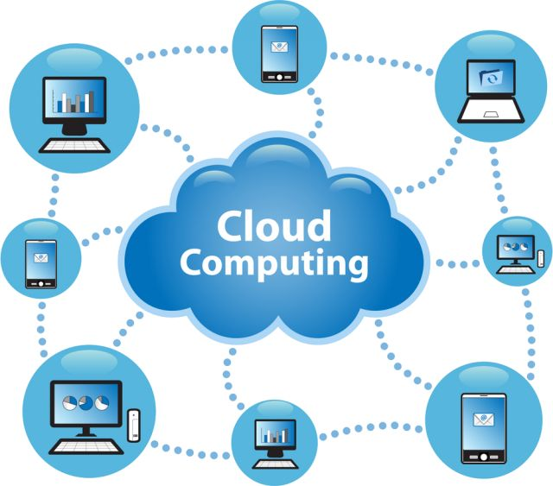
云计算网络架构象征图

Slide 14
硬件：
服务器、网络
2. Concept of Cloud Computing
服务
每一层管理的资源
实例
Business Applications
Web Services, Multimedia
Google Apps,
Facebook,
YouTube
Salesforce.com
软件即服务 (SaaS)
Applications
Runtimes,
Operating System,
Database
Google AppEngine,
Microsoft Azure
平台即服务(PaaS)
Platform
Computing (VM),
Storage
Amazon EC2,
Eucalyptus
OpenNEbula
基础设施即服务 (IaaS)
Infrastructure
Server, Network
Data Centers
Hardware

Slide 15
2. Concept of Cloud Computing
SaaS
CRM, Email, visual desktop,
communication, games…
个人用户，
公司用户
PaaS
Execution runtime, database, web server,
development tools…
个人用户
公司用户
IaaS
Virtual machines, servers, storage,
load balancers, network, etc,…
公司用户
云计算简单架构图
Back

Slide 16
Cloud Delivery Models
（Service Models）
云服务交付模型

Slide 17
3. Cloud Delivery Models
Software as a Service (软件即服务交付模型)
  租用应用软件. Use provider’s applications over a network
  按需租用. On-demand applications
Platform as a Service (平台即服务交付模型)
  将客户开发的应用程序部署到云. Deploy customer-created applications to a cloud
  按需应用程序托管环境 On-demand application-hosting environment
Infrastructure as a Service (基础设施即服务交付模型)
  租用基础设施. Rent processing, storage, network capacity, and other fundamental computing resources
  按需服务器. On-demand servers
Notes:
Cloud Software as a Service (SaaS). The capability provided to the consumer is to use the provider’s applications running on a cloud infrastructure and accessible from various client devices through a thin client interface such as a Web browser (e.g., web-based email). The consumer does not manage or control the underlying cloud infrastructure, network, servers, operating systems, storage, or even individual application capabilities, with the possible exception of limited user-specific application configuration settings.
Cloud Platform as a Service (PaaS). The capability provided to the consumer is to deploy onto the cloud infrastructure consumer-created applications using programming languages and tools supported by the provider (e.g., java, python, .Net). The consumer does not manage or control the underlying cloud infrastructure, network, servers, operating systems, or storage, but the consumer has control over the deployed applications and possibly application hosting environment configurations.
Cloud Infrastructure as a Service (IaaS). The capability provided to the consumer is to provision processing, storage, networks, and other fundamental computing resources where the consumer is able to deploy and run arbitrary software, which can include operating systems and applications. The consumer does not manage or control the underlying cloud infrastructure but has control over operating systems, storage, deployed applications, and possibly select networking components (e.g., firewalls, load balancers).

Slide 18


3. Cloud Delivery Models
= Managed for You | IaaS | PaaS | SaaS
Applications
Runtimes
Database
Operating System
Virtualization
Server
Storage
Network
提供全
套服务
提供
平台
提供
基础
设施
云计算对各种出租服务的配置

Slide 19
SaaS (软件即服务)
3. Cloud Delivery Models
SaaS is a software delivery model in which software and associated data are centrally hosted on the cloud.（软件与数据都在云端）
SaaS is typically accessed by users using a thin client via a web browser.(是将软件和数据部署于云端的一种软件交付模式，客户通常通过浏览器使用软件)
例子： GMail, Google map, 百度地图

Slide 20
3. Cloud Delivery Models
SaaS has become a common delivery model for most business applications, including
  Accounting (会计业务)；
  Invoicing(货品计价)；
  CRM(客户关系管理)；
  MIS(管理信息系统)；
  ERP(企业资源计划)；
  HRM(人力资源管理), etc.
通用应用程序

Slide 21
PaaS (平台即服务)
3. Cloud Delivery Models
PaaS is a category of cloud computing services that provide a computing platform and a solution stack as a service. (将计算平台及方案栈作为服务)
PaaS模型提供了计算平台
In the PaaS model, cloud providers deliver a computing platform and/or solution stack typically including
  operating system, 操作系统
  programming language execution environment,运行环境
  database 数据库
  web server Web服务器
  例：E.g. Google AppEngine

Slide 22
IaaS(基础设施即服务)
3. Cloud Delivery Models
In this most basic cloud service model, cloud providers offer
  computers – as physical or more often as virtual machines, 虚拟机
  raw (block) storage,块存储
  firewalls,防火墙
  load balancers, and负载均衡器
  networks.网络
IaaS providers supply these resources on demand from their large pools installed in data centers. (按需提供)

Slide 23
3. Cloud Delivery Models
In this model, it is the cloud user who is responsible for
  installing, (自行安装)
  patching and (自行修补)
  maintaining (自行维护)
the operating systems and application
software. 操作系统和应用程序
Cloud providers typically bill IaaS services on a utility computing basis, that is, cost will reflect the amount of resources allocated and consumed. (提供商根据资源使用情况计费)
  例：Amazon EC2, VMWare vCloud

Slide 24


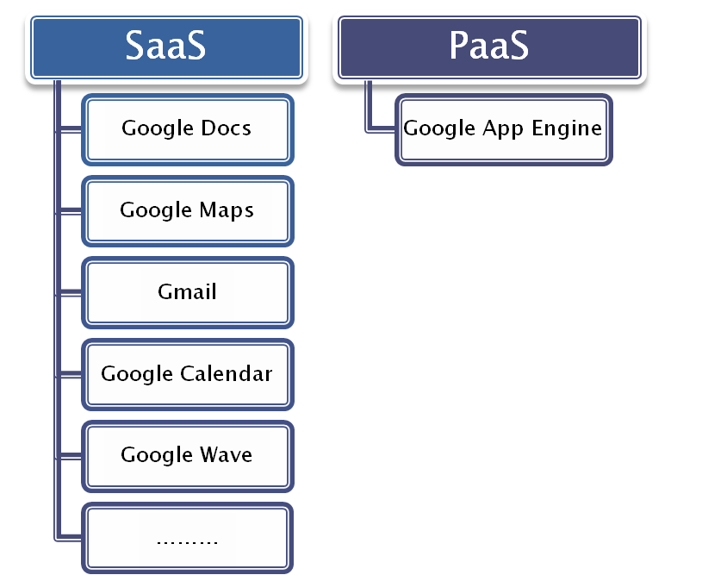



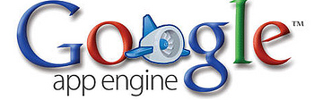
Example: Google
3. Cloud Delivery Models
Google云计算应用实例
Back

Slide 25
Multi-tenant Architecture
SaaS的多租户架构

Slide 26
多租户架构
Multi-tenant Architecture
4. Multi-tenant Architecture
问题：在SaaS中，怎样更经济地将同一个应用程序出租给多个租户？
多租户概念 Multi-tenancy refers to a principle in software architecture where a single instance of the software runs on a server, serving multiple client organizations (tenants). (单个应用实例服务多个租户)
多租户是SaaS中的关键技术

Slide 27
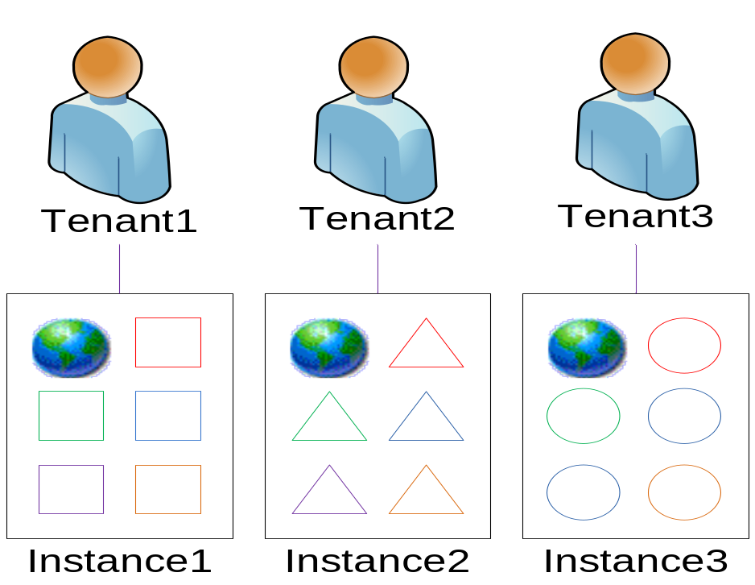
Level 1 - Ad-Hoc / Custom (专门的、定制的)
4. Multi-tenant Architecture
Each customer has its own customized version of the hosted application and runs its own instance of the application on the host's servers.
每个租户都有为其专门定制的应用程序版本。例如财务系统定制版本：
1）清华大学财务系统
2）北大财务管理系统
3）哈工大财务系统

Slide 28
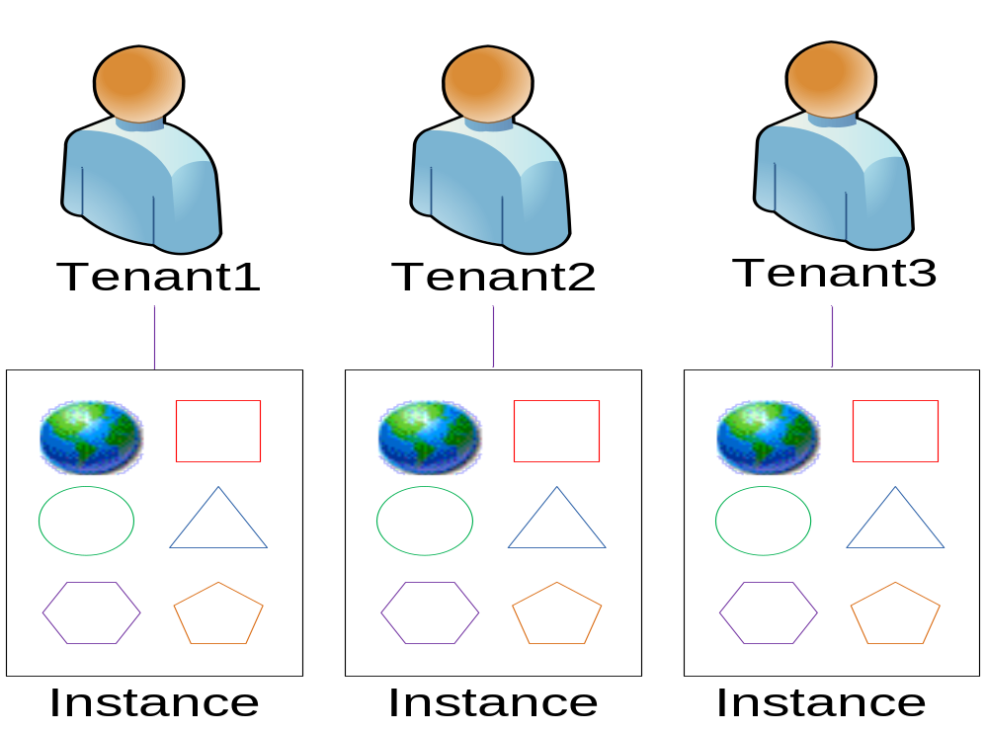
Level 2 – Configurable (可配置的)
4. Multi-tenant Architecture
Greater program flexibility through configurable metadata, so that many customers can use separate instances of the same application code.
通过配置，可以使得许多租户运行同一个应用程序的不同的实例。

Slide 29
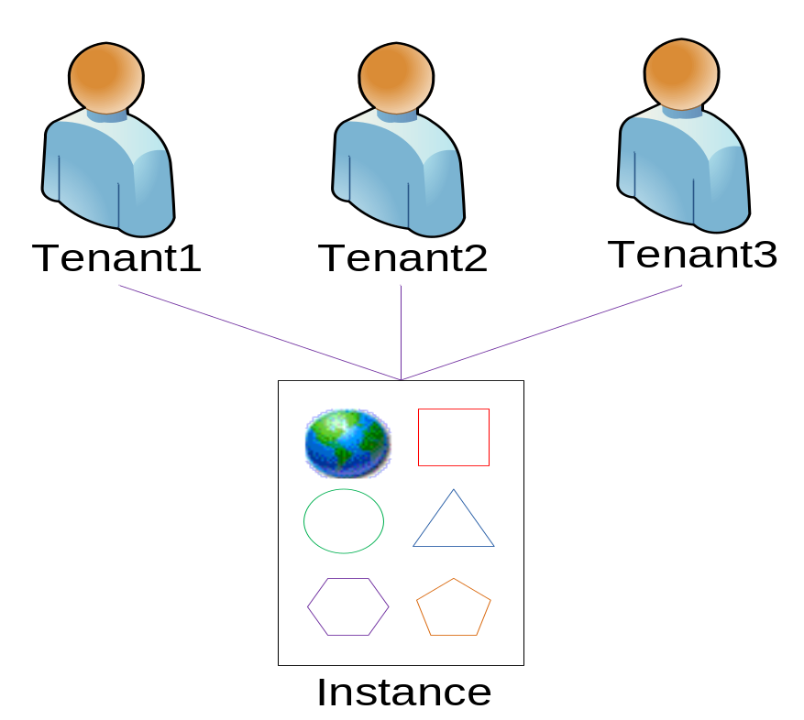
Level 3 - Configurable, Multi-Tenant-Efficient
可配置-多租户-高效率
4. Multi-tenant Architecture
Adds multi-tenancy so that a single program instance serves all customers.
增加多租户机制，使得所有的租户运行同一个应用程序的同一个实例。
问题：怎样区别租户？
难度比较大

Slide 30
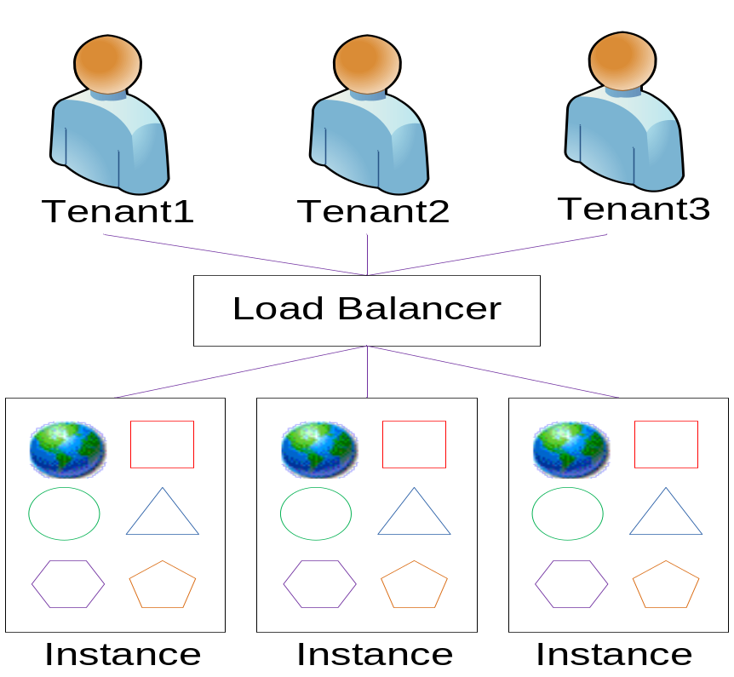
Level 4 - Scalable, Configurable, Multi-Tenant-Efficient 可伸缩的，可配置的，多用户的，高效的
4. Multi-tenant Architecture
Adds scalability through a multi-tier architecture supporting a load-balanced farm of identical application instances, running on a variable number of servers.
增加了可伸缩性，使得所有的租户运行同一个应用程序的同一个实例，运行在许多服务器上。
快速扩展
快速释放
快速收缩.
Back

Slide 31
NIST Architectures of Cloud Computing
云计算NIST架构

Slide 32
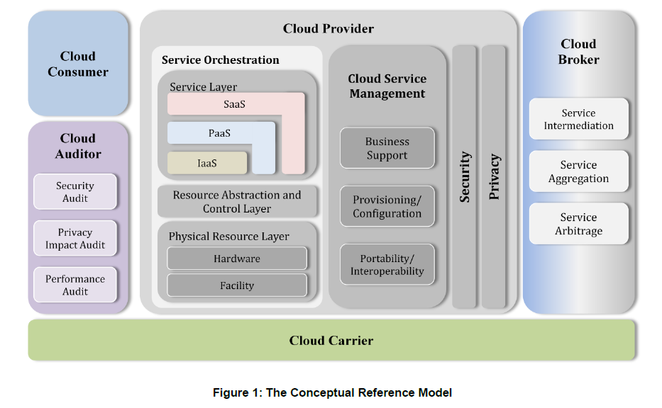
5. Architectures of Cloud Computing
云提供者
云代理者
服务编制
云消
费者
云审
计者
Cloud computing architecture given by NIST
美国国家标准和技术研究院(NIST)给出的云计算模型

Slide 33
5. Architectures of Cloud Computing
角色
云消费者 (Cloud consumer)
云消费者是与云提供商保持业务联系、使用云提供商所提供服务的个人或组织。
对于SaaS模式，消费者通过网络使用服务商提供的使用应用程序；
对于PaaS模式，消费者使用服务或平台开发、测试、部署和管理托管在云平台上的应用程序；
对于IaaS模式，消费者可以访问虚拟机、网络存储、网络基础设施组件以及其它的基础计算资源，可以部署和运行任何软件。

Slide 34
5. Architectures of Cloud Computing
云提供商(Cloud provider)
云提供商是负责向云消费者提供可用服务的个人、组织或实体。
对于SaaS模式，云提供商负责安装、管理、维护云基础设施中的软件应用程序；
对于PaaS模式，云提供商为平台的消费者配置和管理云基础设施和中间件，向其提供开发、部署和管理工具；
对IaaS模式，云提供商通过服务接口和计算资源的抽象,向云消费者提供服务器、网络和存储等基础设施服务。

Slide 35
5. Architectures of Cloud Computing
云审计者 (Cloud auditor)
云审计者是指能够对云服务、信息系统操作、云计算实现的性能和安全开展独立评估的机构。
云代理 (Cloud broker)
云代理是管理云计算服务的使用、性能以及交付的实体，它能够协调提供商和消费者之间关系
云载体 (Cloud carrier)
云载体为云提供商向消费者的云服务提供连接和传输的媒介
Back

Slide 36
Comparison of Grid Computing with Cloud Computing
网格计算与云计算的比较

Slide 37
Grid Computing (网格计算)
6. Comparison of Grid Computing with Cloud Computing
解决大规模的计算问题
To solve large-scale computation problems
  breaking large data sets down into many smaller ones
  modeling a parallel division of labor
网格计算为诸多挑战性的问题提供了解决途径
Grids offer a way to solve Grand Challenge problems such as:
  protein folding (蛋白质折叠)
  financial modelling (经济与金融建模)
  earthquake simulation (地震模拟)
  climate/weather modelling (气候/天气建模)
  astronomical searching (天体搜索)

Slide 38
6. Comparison of Grid Computing with Cloud Computing
网格计算
云计算
异构资源
不同机构
虚拟组织
科学计算为主
标准化
科学界
同构资源
单一机构
虚拟机
数据处理为主
标准正在制定（？）
商业社会
Back

Slide 39
Key Technologies of Cloud Computing
云计算关键技术

Slide 40
关键技术1：Virtualization (虚拟化)
7. Key Technologies of Cloud Computing
Virtualization is the creation of a virtual (rather than actual) version of something, such as a
  hardware platform, 虚拟硬件平台
  operating system, 虚拟操作系统
  storage device, or 虚拟存储设备
  network resources. 虚拟网络资源
  Server 虚拟服务器
你可以在Baidu, Aliyun, Amazon上租用虚拟服务器。

Slide 41
关键技术2：大规模分布式数据存储(big data)
7. Key Technologies of Cloud Computing
大数据概念：Big data refers to data sets whose size is beyond the ability of commonly used software tools to capture, manage, and process within a tolerable elapsed time. (数据量巨大、传统软件数据处理工具无法在可接受的时间内处理完)
问题：
It’s hard to work with it using relational databases (无法使用关系型数据库)
Require “massively parallel software running on hug number of servers”(需要数以千计的服务器并行处理)

Slide 42
7. Key Technologies of Cloud Computing
大规模分布式数据存储实例: GFS
Google文件系统(Google File System，GFS)是构建在廉价的服务器之上的大型分布式系统。它将服务器故障视为正常现象，通过软件的方式自动容错。保证了系统可靠性、可用性，大大减少了系统的成本。
GFS是Google云存储的基石。另外，Google大规模批处理系统MapReduce也需要利用GFS作为海量数据的输入输出。

Slide 43
7. Key Technologies of Cloud Computing
GFS架构
  将文件划分为若干块(Chunk)存储，每块64M。服务器给每块分配一个不变的、全球唯一的64位的块句柄对它进行标识。
  单一Master, 多个ChunkServer，通过master协调数据访问、元数据（描述数据及其环境的数据）存储
  ChunkServer把块作为linux文件保存在本地硬盘上，并根据指定的块句柄和字节范围来读写块数据。通过冗余提高可靠性：每个数据块至少在3个ChunkServer上冗余
  客户端跟Master交互进行元数据操作，但所有的数据操作的通讯都是直接和ChunkServer进行的。

Slide 44
负责数据
块存储
File 1
Trunk 1
直接访问Trunk服务器
Trunk
Server 1
File 1
Trunk 2
File 2
Trunk 1
冗余
Trunk
映射
File 1
Trunk 2
App
Master
Trunk
Server 2
File 1
Trunk 1
负责数据
块存储
File 2
Trunk 2
协调数据访问、
元数据存储
File 1
Trunk 2
直接访问Trunk服务器
Trunk
Server 3
File 2
Trunk 1
负责数据
块存储
File 2
Trunk 2
GFS架构图

Slide 45
关键技术3：Mass Data Processing(海量数据处理)
7. Key Technologies of Cloud Computing
待处理数据量巨大（PB级），只有分布在成百上千个节点上并行计算才能在可接受的时间内完成，例如：
  谷歌搜索索引的构建
  雅虎垃圾邮件检测
1K = 2的10次方 Byte | 1EB = 2的60次方 Byte
1M = 2的20次方 Byte | 1ZB = 2的70次方 Byte
1G = 2的30次方 Byte | 1YB = 2的80次方 Byte
1TB = 2的40次方 Byte | 1DB = 2的90次方 Byte
1PB = 2的50次方 Byte | 1NB = 2的100次方Byte
Notes:
MapReduce: Simplified Data Processing on Large Clusters,
Communications of the ACM, vol. 51, no. 1 (2008), pp. 107-113
Jeffrey Dean and Sanjay Ghemawat.

Slide 46
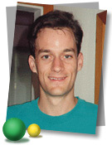
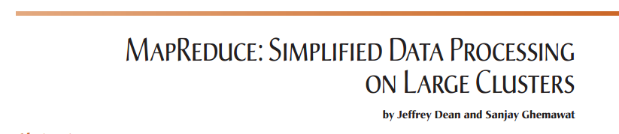
7. Key Technologies of Cloud Computing
如何进行并行分布式计算(有一些算法)
MapReduce is
  a programming model and
  an associated implementation for processing and generating large
  datasets
  introduced by Jeffery Dean in 2004.
Back

